Slide 1
A Survey of South American Lizards Biodiversity and Ecological

Slide 2
Introduction
South America is home to a diverse array of lizard species, each contributing to the continent's intricate ecosystems. This comprehensive research explores the fascinating world of South American lizards, highlighting the unique characteristics, habitats, and ecological significance of three remarkable species. Additionally, we examine the threats these lizards face and the conservation efforts in place to protect them.

Slide 3
Dactyloidae The Anoles are members of the Dactyloidae family and several species inhabit
Lizards are a diverse group of reptiles found in various habitats across South America. Several families of lizards inhabit the continent, each with its unique characteristics and ecological roles.

Slide 4
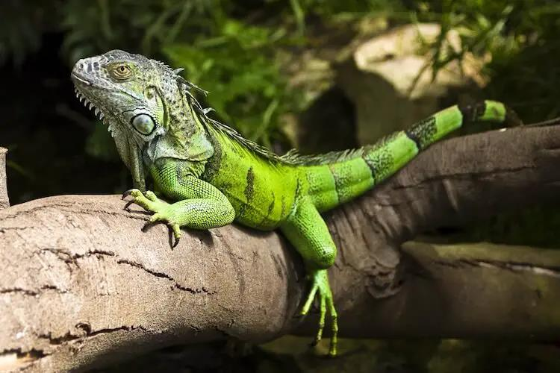

Slide 5
welladapted to a semiaquatic lifestyle spending
The Green Iguana, Caiman Lizard, and Tepui Lizard are three remarkable reptile species found in South America. Each species has developed unique adaptations that allow them to thrive in their respective environments. They play important roles in their ecosystems and face various threats that impact their survival.

Slide 6
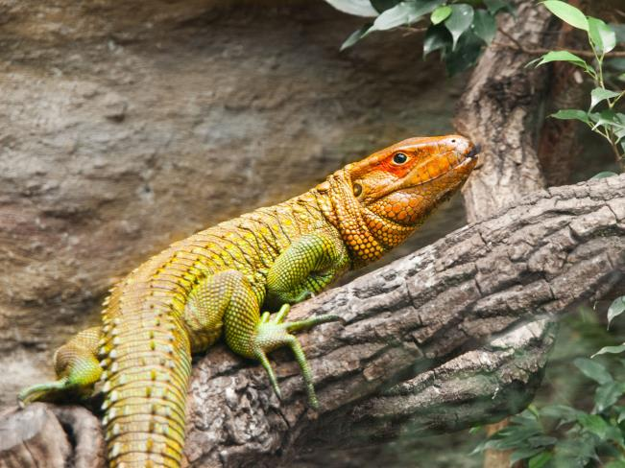

Slide 7
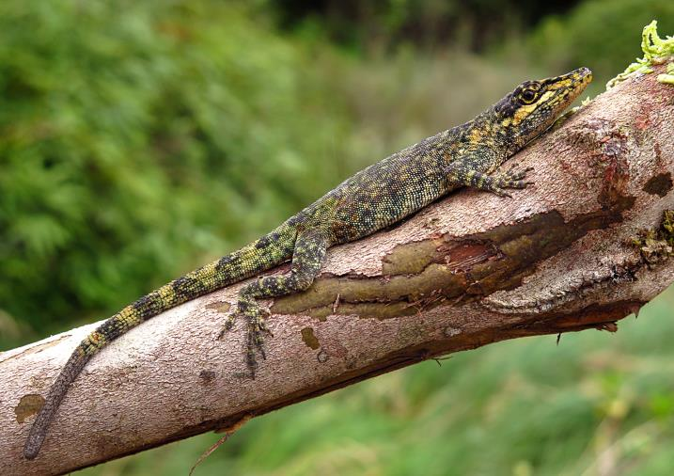

Slide 8
Furthermore habitat fragmentation restricts their movements and limits access to essential
South American lizards, including the Green Iguana, Caiman Lizard, and Tepui Lizard, are fascinating creatures that play crucial ecological roles in their respective habitats. However, they face numerous threats, such as habitat loss, climate change, and illegal trade, which necessitate urgent conservation efforts.

Slide 9
As we embark on a journey of understanding and safeguarding these extraordinary reptiles let
South American lizards are an integral part of the continent's natural heritage, providing vital contributions to its ecological stability. Preserving their diversity is essential to uphold the integrity of delicate ecosystems and ensure the world's irreplaceable biodiversity.

